Slide 1
Research Methodology- Unit 5 DATA COLLECTION AND ANALYSIS
Prime College- BIM 6th Semester

Slide 2
Research Methodology- Unit 5 Chapter 6- Statistical Analysis-Descriptive Data
Prime College- BIM 6th Semester

Slide 3


Learning Outcome 1
Quantitative Data Analysis Methods
Descriptive Data Analysis
Measures of Central Tendency

Slide 4
Statistical Methods
Statistics: “meaningful” quantities about a sample of objects, things, persons, events, phenomena, etc.
Widely used in social sciences.
Simple to complex issues. E.g.
* correlation
* anova
* regression
* econometric modelling
Two main categories:
* Descriptive statistics
* Inferential statistics

Slide 5
Descriptive statistics
Inferential statistics
Use sample information to explain/make abstraction of population “phenomena”.
Using sample statistics to infer some “phenomena” of population parameters
* Association
* Tendency (left-skew, right-skew)
* Causal relationship (e.g. if X, then, Y)
* Trend, pattern, dispersion, range

Slide 6
Principles of data analysis
Basic guide to data analysis:
* “Analyse” NOT “narrate”
* Go back to research flowchart
* Break down into research objectives and
research questions
* Validate the answers with data
* Don’t tell something not supported by
data

Slide 7
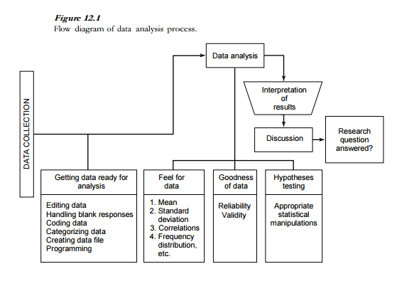
Data Analysis – Uma Sekaran

Slide 8
Data Analysis
In data analysis we have three objectives:
getting a feel for the data,
testing the goodness of data, and
testing the hypotheses developed for the research.
We can classify analysis into three types:
Univariate analysis, involving a single variable at one time
Bivariate analysis, involving two variables at a time
Multivariate analysis, involving three or more variables simultaneously

Slide 9
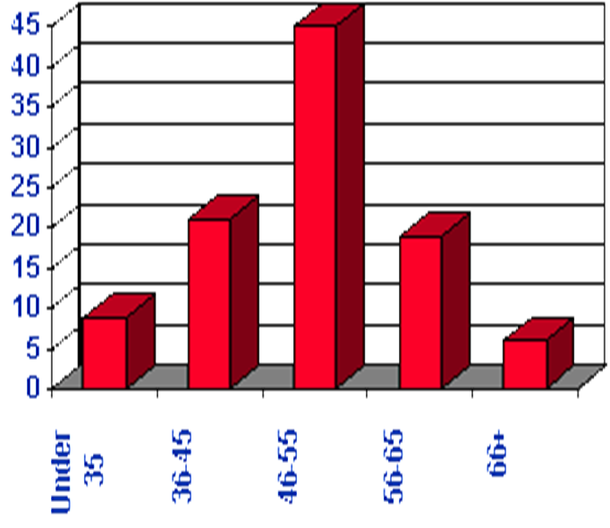
1. Feel of the data
We can acquire a feel for the data by checking the central tendency and the dispersion.
Examination of the measure of central tendency, and how clustered or dispersed the variables are, gives a good idea of how well the questions were framed for tapping the concept
The statistics give feel for the data:
Frequency distributions – For categorical variables
The mean, standard deviation, range, and variance on the other dependent and independent variables
The mean, the range, the standard deviation, and the variance in the data will give the researcher a good idea of how the respondents have reacted to the items in the questionnaire and how good the items and measures are. Source: Sekaran: 2003
Frequency Distributions
Mean, SD
Range

Slide 10
Descriptive Statistics
3 Types
Organize data
Frequency Distributions
3. Summary Stats
# of items that fall
in a particular category
Describe data in just one
number
2. Graphical Representations
Graphs & Tables

Slide 11
Descriptive Statistics
Number
Frequency Count
Percentage
Measures of Central Tendency
Mean
Median
Mode
Variability
Variance and standard deviation
Graphs
Normal Curve
Mode – the most frequently occurring observation
Median – the middle value in the data (50 50 )
Mean – arithmetic average
Describe what's going on in our data.

Slide 12
Basic Statistics
Measures of Central Tendency
Measures of central tendency are measures of the location of the middle or the centre of a distribution.
Mean
The arithmetic mean (AM), commonly known as mean or average, is the most often used measure of central tendency. The mean is computed by adding all the data values together and dividing by n, where n represents the total number of data values. Symbolically,

Slide 13
Median
Example
Ordered Array includes:
3 4 5 7 8 9 11 14 15 16 16 17 19 19 20 21 22
There are 17 terms in the ordered array.
Position of median = (n+1)/2 = (17+1)/2 = 9
The median is the 9th term, 15.
The median of a set of scores represents the middle value (50th percentile) when the scores are arranged as an array in ascending or descending order.
To calculate the median, first rank the scores in ascending or descending order and follow these two guidelines:
For an odd number of scores, the median is the middle score.
For an even number of scores, the median is the mean (arithmetic average) of the two middle scores.

Slide 14
Mode
The mode represents the most frequently occurring score. When two scores occur with the same greatest frequency, each one equals the mode and the data set is considered bimodal. When more than two scores occur with the greatest frequency, the data set is said to be multimodal.
35
41
44
45
37
41
44
46
The mode is 44.
There are more 44s
than any other value.
37
43
44
46
39
43
44
46
40
43
44
46
40
43
45
48

Slide 15
Measures of Dispersion
Standard Deviation
Measures of dispersion or variability give us information about the spread of the scores in our distribution.
The standard deviation (SD) plays a dominating role for the study of variation in the data and it is the most widely used measure of dispersion.

Slide 16
In short,
Central Tendency
If there are 100-2- or 1000 samples and if we need to calculate an average value; the value that will represent all the samples then that is central tendency. The calculation of central tendency is known as Measurement of Central Tendency.
Methods- Mean, Median and Mode.
Mean- Most common method
Eg: 9 women having Haemoglobin- 12, 13, 12, 11.5, 11, 14, 9, 7, 11
Mean = (12+13+12+11.5+14+9+7+11)/ 9
Eg: 100 adolescent girls
Age (year) | No. of students | fx
16 | 35
17 | 31
18 | 20
19 | 74
Total | 100 | Efx

Slide 17
In short,
Median
Median= (n+1)/2
Data set: 10, 20, 30, 20, 40, 20, 10 – Mean= 21.42
If the no. of data set value is odd, the median is the middle value when arranged in ascending order i.e.
10, 10, 20, 20, 20, 30, 40, Thus Median= 20
If the no. of data set value is even, the median is the average of two middle value when arranged in ascending order

Slide 18
In short,
Mode
Frequently occurring value: 20

Slide 19
Variance
Variance is another absolute measure of dispersion. It is defined as the average of the squared difference between each of the observations in a set of data and the mean. The variance is denoted by and is calculated as:

Slide 20
In short,
Measure of Spread ( Variability)
Analyzing how disperse the distribution is for the given set of data
Measures of central tendency will provide average of data then measure of spread describes how the data is distributed within the set.
Methods- Range, Variance, Standard Deviation

Slide 21

In short,
Range
Data set
49,50,58,58,60,62,66,68,70
Mean= 61.3
Range= Max. Value- Min. Value= 72-49= 23
Variance
⁻¹
= [(49-61.3)² + (50-61.3)² + …… (72-61.3)² ]/ n-1 = 62.23

Slide 22
In short,
Standard Deviation
Data set
49,50,58,58,60,62,66,68,70
Range= Max. Value- Min. Value= 72-49= 23
Variance
⁻¹
= [(49-61.3)² + (50-61.3)² + …… (72-61.3)² ]/ n-1 = 62.23

Slide 23
End of Chapter 6
(Click the arrow when in Slide Show mode)
Notes:
In Slide Show mode, click the arrow to enter the PowerPoint Getting Started Center.

